Slide 1
Real time violence detection
Abdullah Alhammad
Adnan Alshehri
Abdullah Altuwaijri

Slide 2

Agenda
Ideation and Dataset
Tools
Architecture
Demo

Slide 3

Introduction
Our project, Smart-City CCTV Violence Classification, focuses on creating a system that can analyze surveillance videos from smart city CCTV cameras and classify them.

Slide 4

Dataset overview:
Our dataset, the Smart-City CCTV Violence Detection dataset (SCVD), is unique because it exclusively contains real surveillance footage from smart city CCTV cameras. It categorizes videos into three main classes: Non-Violence, Violence, and Weapon Violence. Unlike other datasets, it accurately represents real-world scenarios and includes a class for weapon detection in videos, going beyond traditional datasets that focus only on guns and knives.
The Dataset has only 482 videos.

Slide 5



TOOLS

Slide 6
Architecture
Different type of Architecture.

Slide 7
Architectural structure
3D CNN
3D CNN (Pre-trained)
LSTM (Pre-trained)
A manually designed and flexible model with three dimensional.
Highest degree of flexibility
No pre-trained.
A three-dimensional with pre-trained model
More straightforward architecture
Efficient_x3d_xs pre-trained.
(RNN) optimized for handling sequential data.
More data-efficient than 3D CNNs.
ResNet50 pre-trained.

Slide 8
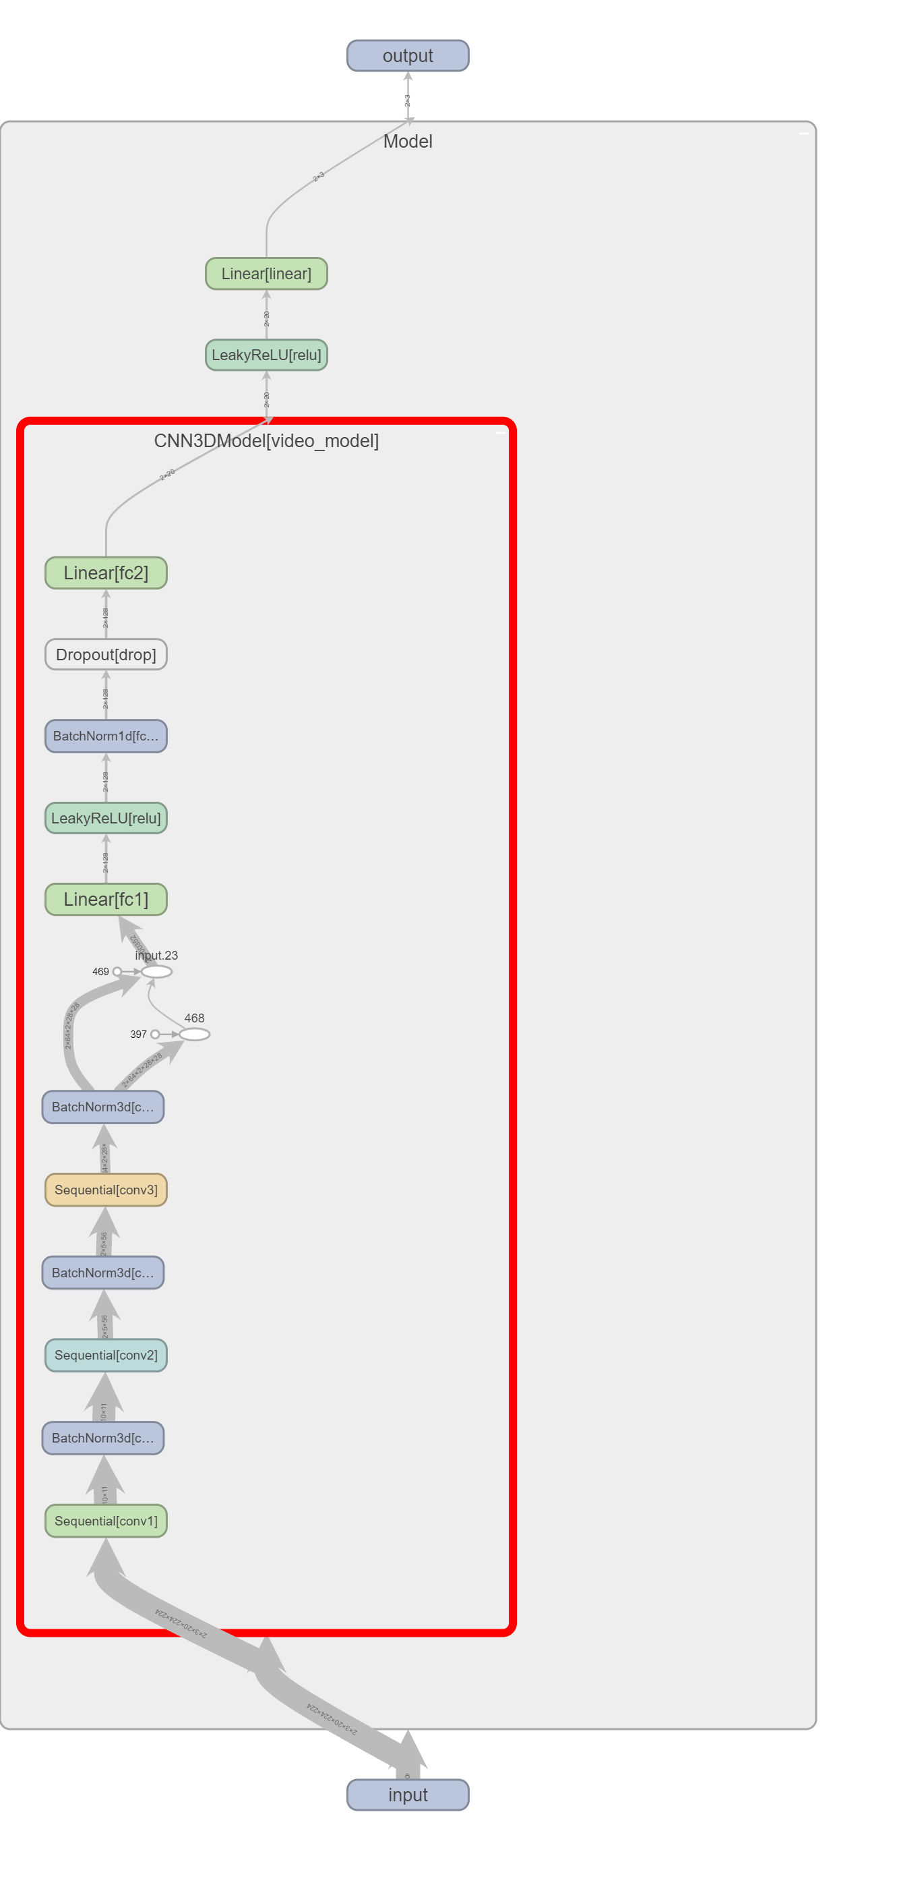
Architectural structure
3D CNN
A manually designed and flexible model with three dimensional.
Highest degree of flexibility
No pre-trained.

Slide 9
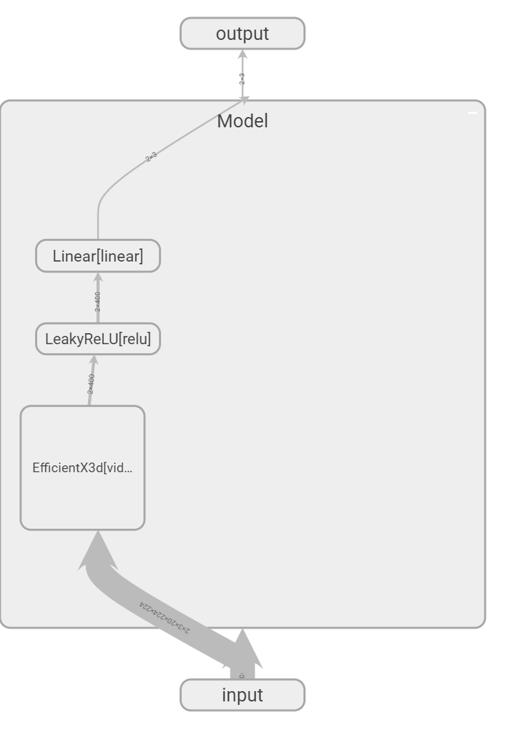
Architectural structure
3D CNN (Pre-trained)
A three-dimensional with pre-trained model
More straightforward architecture
Efficient_x3d_xs pre-trained.

Slide 10
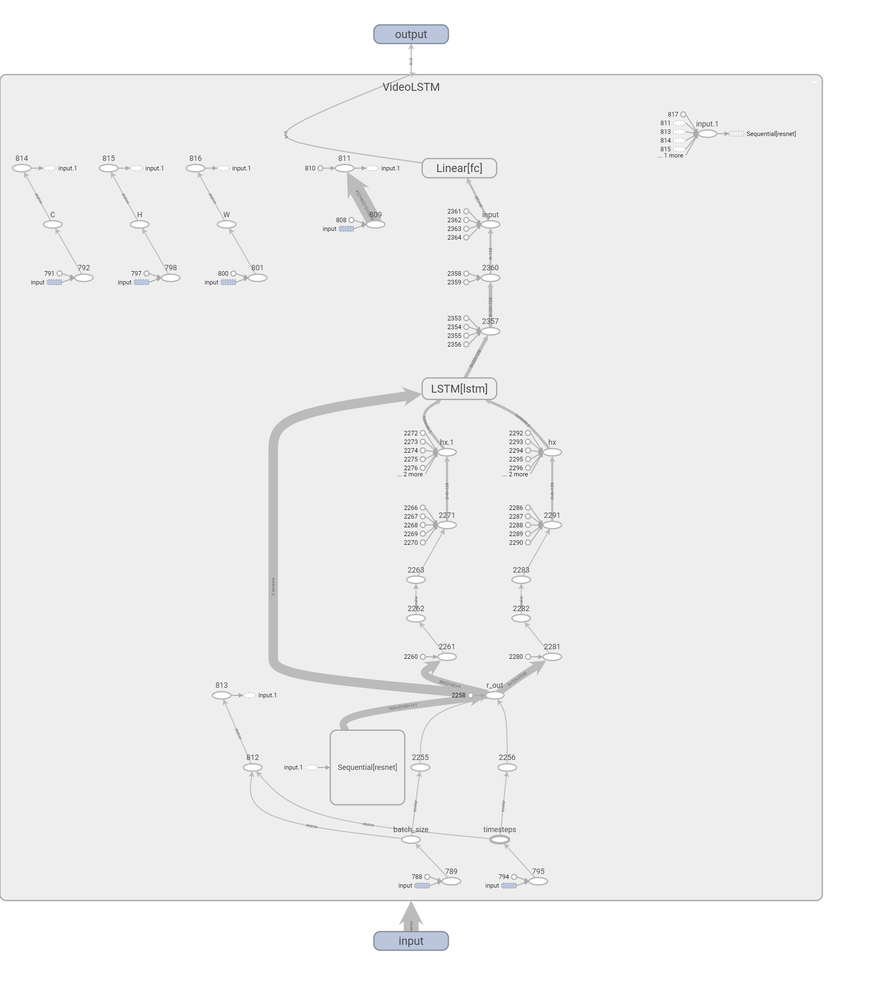
Architectural structure
LSTM (Pre-trained)
(RNN) optimized for handling sequential data.
More data-efficient than 3D CNNs.
ResNet50 pre-trained.

Slide 11
Architectures result

Slide 12

DEMO

Slide 13



Thank you
We welcome your questions and comments.

